Slide 1
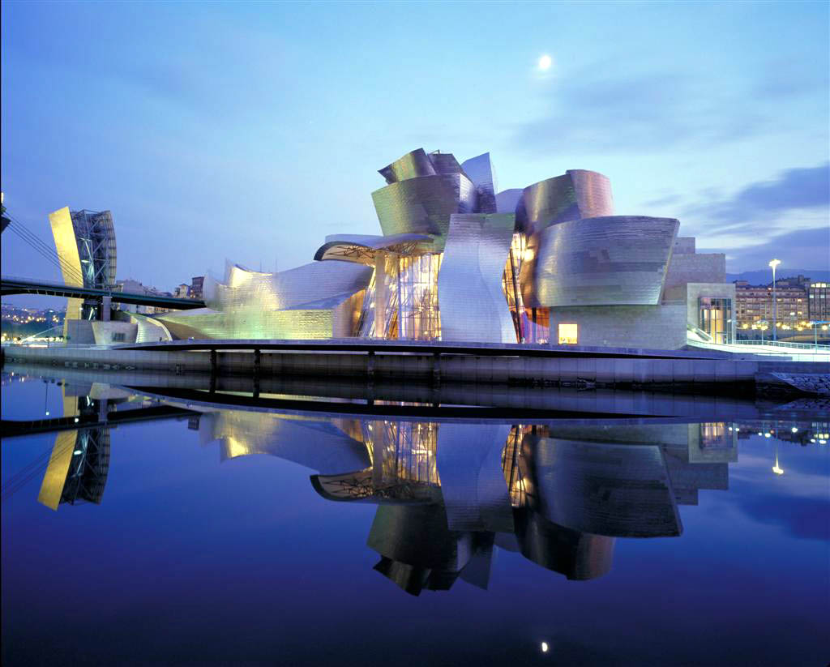
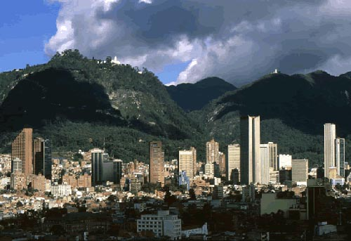
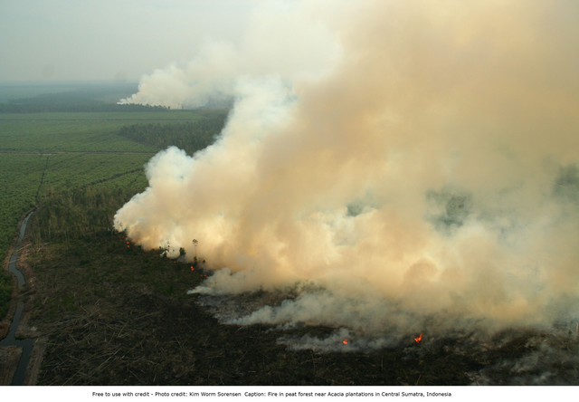
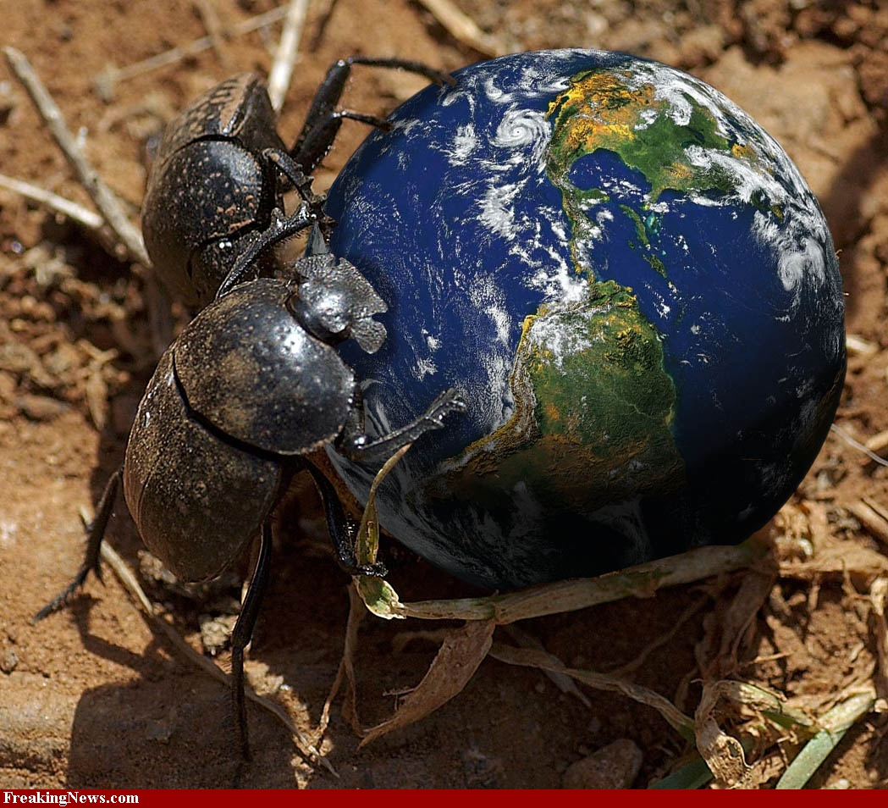

Slide 3
Naikoa Aguilar-Amuchastegui
Forest Carbon Scientist
REDD+
Forest and Climate Initiative
http://www.conservation.org/learn/climate/solutions/mitigation/Pages/climate_REDD.aspx

Slide 4
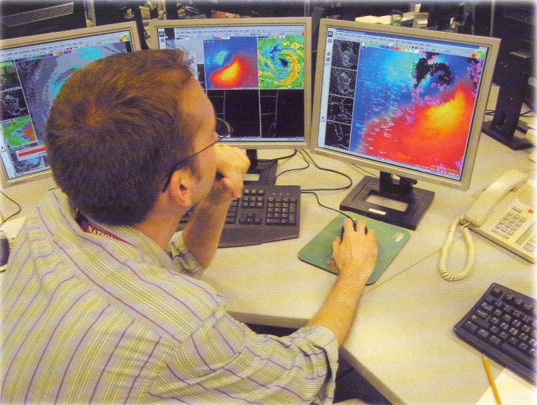
Introduction to Geographic Information Systems (GIS)
EVS 485

Slide 5
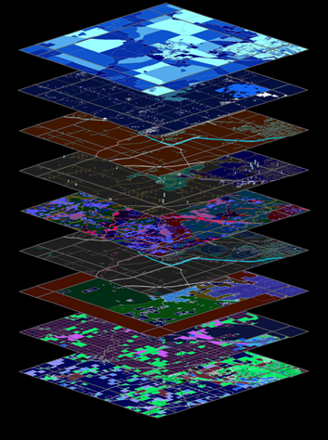
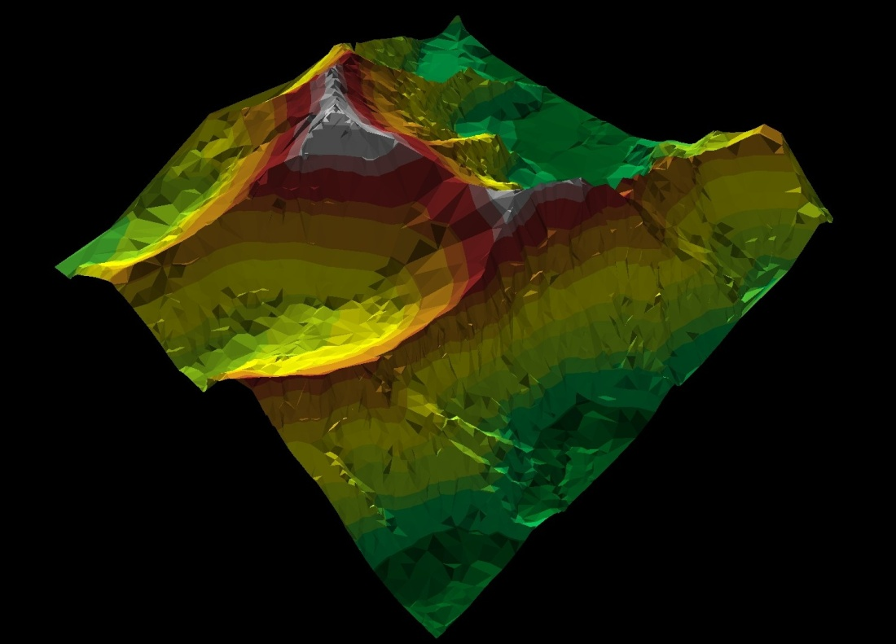

Slide 6
Spatial Data
Map categories (e.g. Roads, Real Estate)
Data base
Class, Speed limit, Surface type
Analysisinterface
Software
Hardware

Slide 7
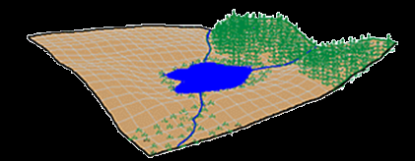
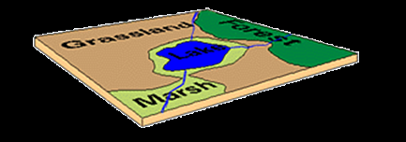
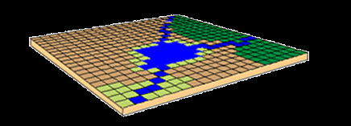
Representing Cartographic Objects Raster and Vector Data Structures
Real World
Raster Representation
Vector Representation

Slide 8
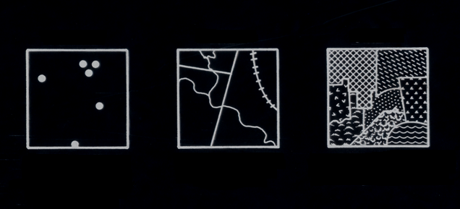
Things are represented by Cartographic Objects
Points
Lines
Areas
Individuals
Populations
Locations
Limits
Paths
Streams Transects
Land Cover Ecoregion Watershed
Reef
Scale
Class
Do rivers or roads (linear features) have width?
Do point features have area?

Slide 9
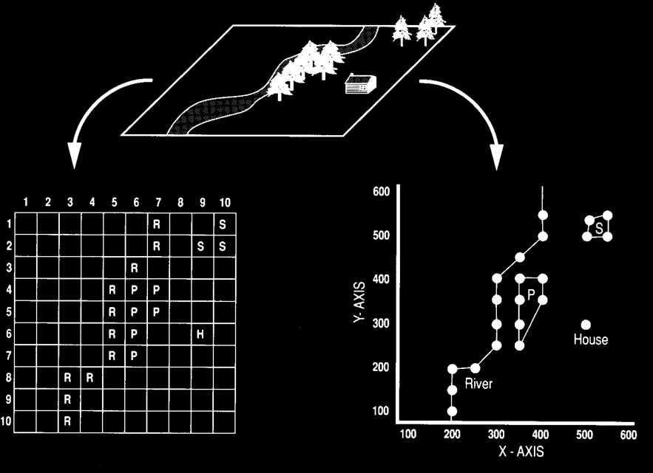

Slide 10
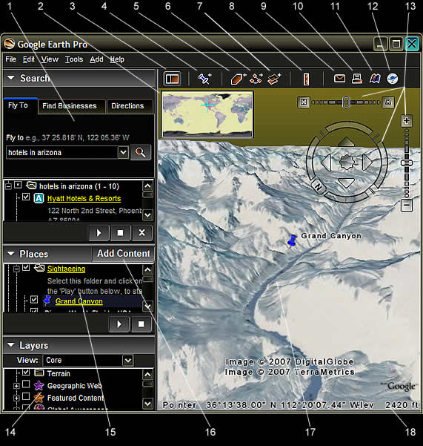
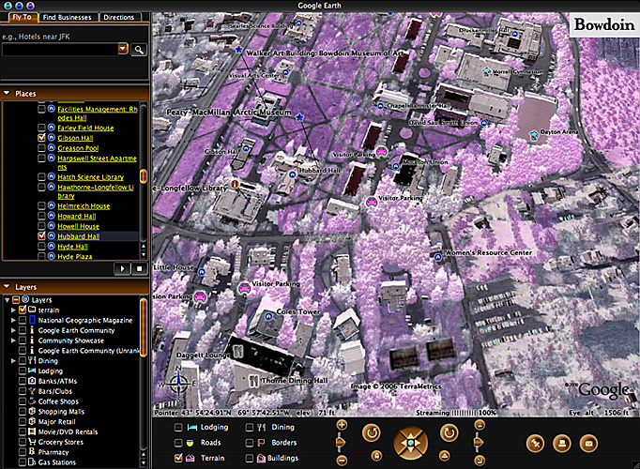
Maps (layers)
Databases (by Theme)
Mappable things (features)
Attributes

Slide 11
GIS
Allows Manipulation
Editing
Analysis
Computer interface
Decision making
Problem study
Modeling

Slide 12
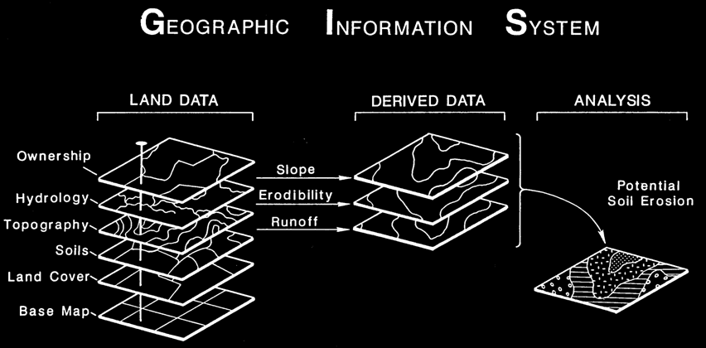
Information System (Group of data bases)
GIS

Slide 13
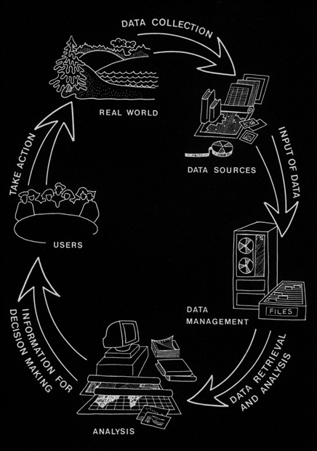
Data Analysis – The Heart of GIS Problem: Identifying Potential Sites for Industry
2
1
3
5
4

Slide 14
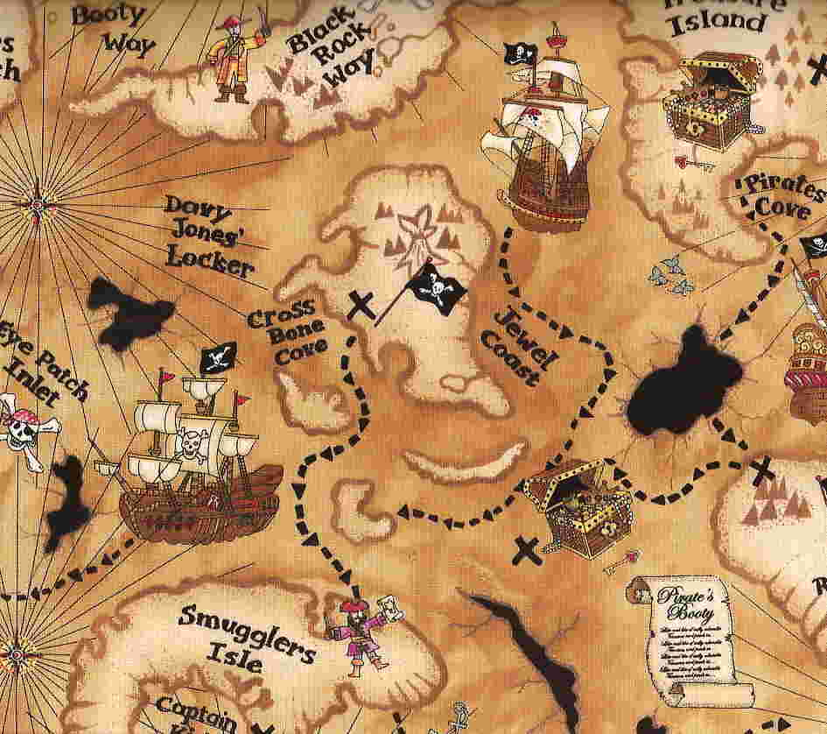
We have a Party!

Slide 15
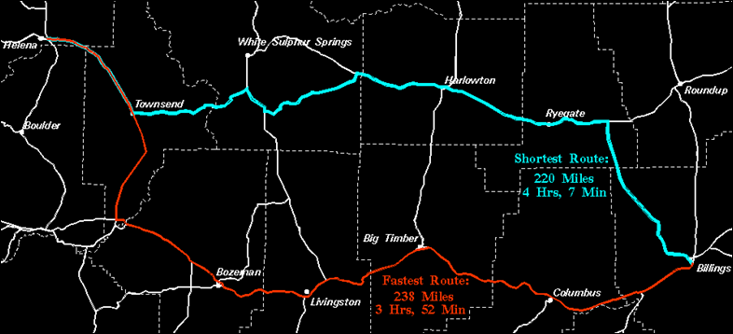
Network Analysis (Routing)

Slide 16
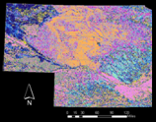
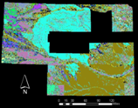
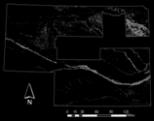
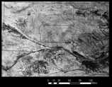
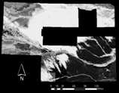
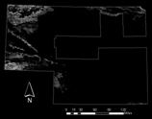
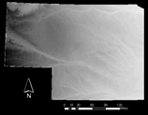
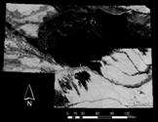
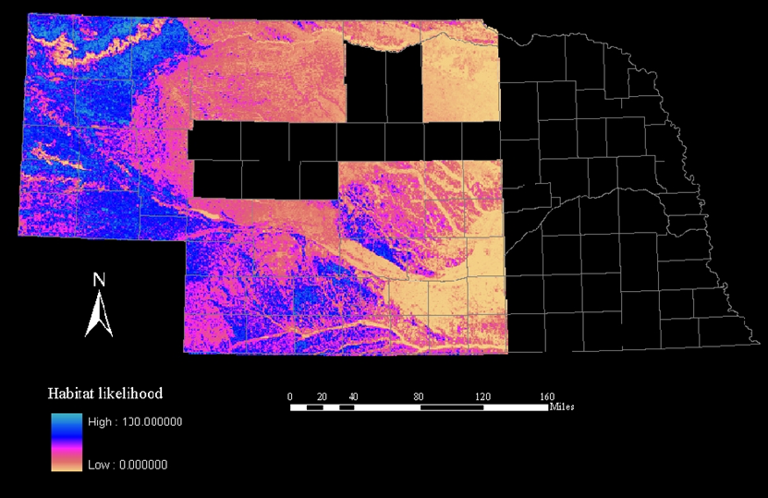
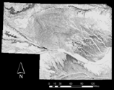
Spatial Modeling
Allocation of conservation incentives in Nebraska?
Land use/cover
NDVI
Elevation
Slope
Soil Texture
Percent silt
Percent sand
Percent clay
Depth
To water table
To bedrock

Slide 17
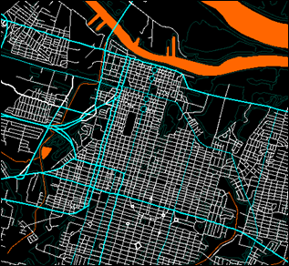
Raster and Vector Data
Digital Elevation Model (DEM) – Raster
Cells (pixels)
Roads, Rivers, locations – Vector
Points, lines and Polygons

Slide 20
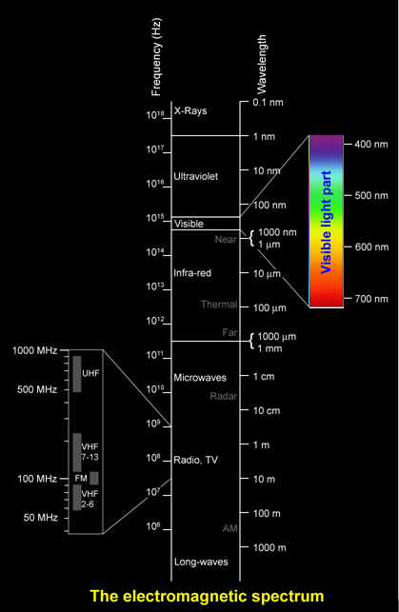
So we measure the EMR that comes (emitted or reflected) from an object of interest and try to figure out its meaning!!!
Actually we do it all the time!!!!
We just need mindset training.

Slide 22
“ Today, GIS is to mapping what word processing is to writing” James Merchant Ph.D

